Slide 1
KEY LOGGER AND SECURITY
NAAN MUDHALVAN TNSDC PROJECT
Presented By:
Reg.no:911721104082
SAKTHI PRIYA M. – Department of Computer science and engineering
Mountzion college of engineering and technology, Pudukkottai

Slide 2
OUTLINE
Problem Statement (Should not include solution)
Proposed System/Solution
System Development Approach (Technology Used)
Algorithm & Deployment
Result (Output Image)
Conclusion
Future Scope
References

Slide 3
Problem Statement
In an era dominated by digital interactions, the proliferation of keylogging threats stands as a formidable challenge in cybersecurity. Keyloggers, clandestine software designed to covertly monitor and record keystrokes, represent a significant risk to both individuals and organizations. Capable of capturing sensitive information including passwords, financial credentials, and personal communications, keyloggers jeopardize user privacy and financial security. As these threats continue to evolve in sophistication and prevalence, the need for robust detection and prevention measures becomes increasingly urgent. Addressing this challenge requires innovative solutions capable of effectively identifying and thwarting keylogging activities to safeguard against the pervasive threat of data theft and privacy breaches.

Slide 4
Proposed Solution :
Our proposed solution aims to confront the menace of keylogging threats head-on by deploying a robust detection and prevention framework. This comprehensive approach encompasses the following key components:
Enhanced Detection Mechanism:
Develop advanced algorithms leveraging event-driven programming to continuously monitor keyboard activities for suspicious patterns indicative of keylogging behavior.
Implement heuristic analysis techniques to detect anomalies in keystroke patterns and identify potential keylogger activity in real-time.
Proactive Response Strategies:
Integrate an alerting system to notify users promptly upon detection of suspicious keystroke behavior, empowering them to take immediate action to safeguard their sensitive information.
Employ secure input handling mechanisms at the application level to mitigate the risk of keylogger interception, including encryption of keystrokes and secure password entry dialogs.

Slide 5
Proposed Solution - continuation :
Continuous Monitoring and Adaptation:
Establish a framework for ongoing monitoring and updates to the keylogger detection system, ensuring its resilience against evolving threats and vulnerabilities.
Regularly update the system with patches and enhancements to bolster detection capabilities and address emerging security challenges effectively.
Rigorous Evaluation:
Conduct comprehensive testing and validation of the detection system to assess its performance metrics, including detection accuracy, false positive rate, and response time.
Evaluate the system's effectiveness in real-world scenarios to ensure its reliability and efficacy in safeguarding against keylogging threats.

Slide 6
System ApproacH (Technology Used):
The system development approach involves utilizing Python programming language along with libraries such as tkinter for GUI development and pynput for keyboard monitoring. Python's simplicity, versatility, and extensive library support make it an ideal choice for developing security applications. The tkinter library provides an intuitive and platform-independent GUI framework, enabling us to create an interactive interface for users to start and stop the keylogger easily. Additionally, the pynput library facilitates keyboard event monitoring, allowing us to capture keystrokes and respond to key press and release events effectively.

Slide 7
Algorithm & Deployment
The keylogger system utilizes event-driven programming, continuously monitoring keyboard events via pynput's keyboard listener.
Upon detecting key press and release events, the system logs the corresponding keystrokes, categorizing them based on their status as pressed, held, or released.
Deployment of the system is achieved by packaging the Python code into an executable file using tools like PyInstaller or cx_Freeze.
This packaging ensures easy installation and usage across various operating systems, eliminating the need for users to have Python installed on their systems.

Slide 8
Result
The output image of the system showcases a user-friendly graphical interface, featuring prominently displayed buttons for initiating and terminating the keylogging process.
The interface design ensures ease of use, enabling users to interact with the keylogger application effortlessly.
In addition to the start and stop buttons, the interface may incorporate visual indicators or status updates to inform users about the current state of the keylogger, enhancing user awareness and control.

Slide 9
Result - continuation
The system may also include notifications or alerts to promptly notify users of any detected keylogging activities, enabling timely intervention to mitigate potential security threats.
Overall, the output image demonstrates the system's commitment to providing a seamless user experience while prioritizing transparency and security in keylogging detection and prevention.

Slide 10
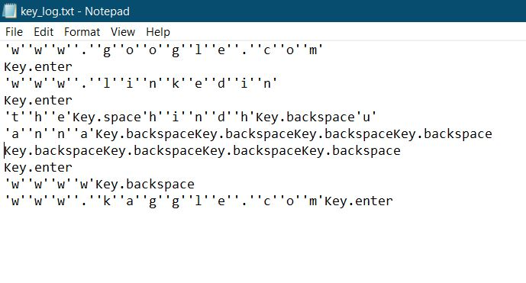
OUTPUT SCREENSHOTS :
This is how the output text file of keylogger looked like
Name of the File: key_log.txt

Slide 11
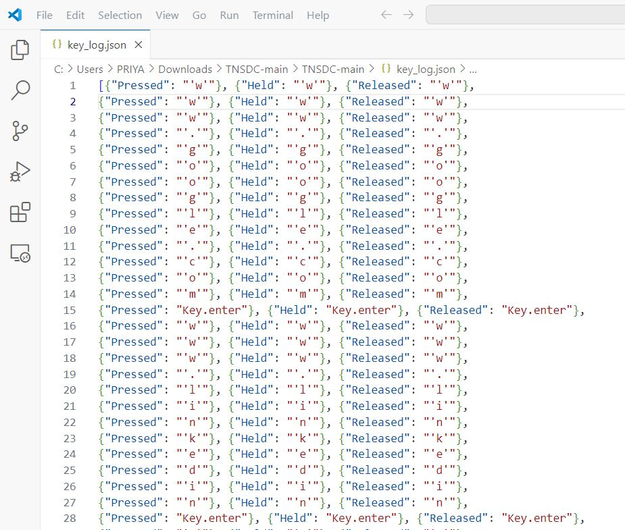
OUTPUT SCREENSHOTS :
This is how the JSON output file of keylogger looked like
Name of the File: key_log.json

Slide 12
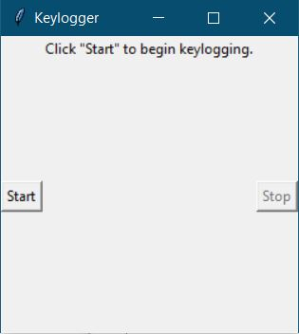
OUTPUT SCREENSHOTS :
This is how the User interface of Keylogger looks like.
It has 2 buttons:
Star
stop

Slide 13
Conclusion
In conclusion, the development of a keylogging detection and prevention system using Python provides an effective means to enhance cybersecurity by safeguarding against keylogging attacks. By leveraging Python's libraries and event-driven programming paradigm, we have created a user-friendly application capable of detecting and alerting users about potential keylogging activities on their system. Through continuous monitoring and logging of keystrokes, the system empowers users to take proactive measures to protect their sensitive information and maintain the integrity of their digital assets..

Slide 14
Future scope
The keylogger project opens avenues for further enhancements and extensions to improve its functionality and effectiveness. Future scope includes incorporating machine learning algorithms for advanced anomaly detection, integrating with cloud-based storage for secure log storage and analysis, and developing mobile applications for remote monitoring and control. Additionally, expanding the system's capabilities to detect and prevent other forms of cyber threats, such as phishing attacks and malware infections, can enhance overall cybersecurity posture.

Slide 15
References
Python Documentation: https://docs.python.org/3/
tkinter Documentation: https://docs.python.org/3/library/tkinter.html
pynput Documentation: https://pypi.org/project/pynput/
"Mastering Python for Networking and Security" by José Manuel Ortega.

Slide 16
THANK YOU

